Slide 1



BSS Case Competition
X

Slide 2
➔ Agenda
#1 Introducing s360
#2 JYSK as a Company
#3 Presenting the case
#4 Closing Marks

Slide 3
➔ Agenda
#1 Introducing s360
#2 JYSK as a Company
#3 Presenting the case
#4 Closing Marks

Slide 4
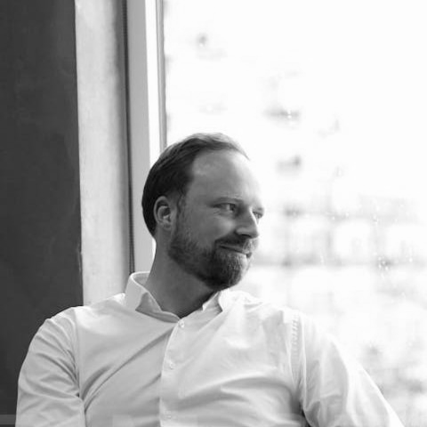
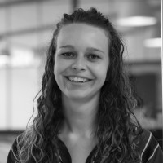
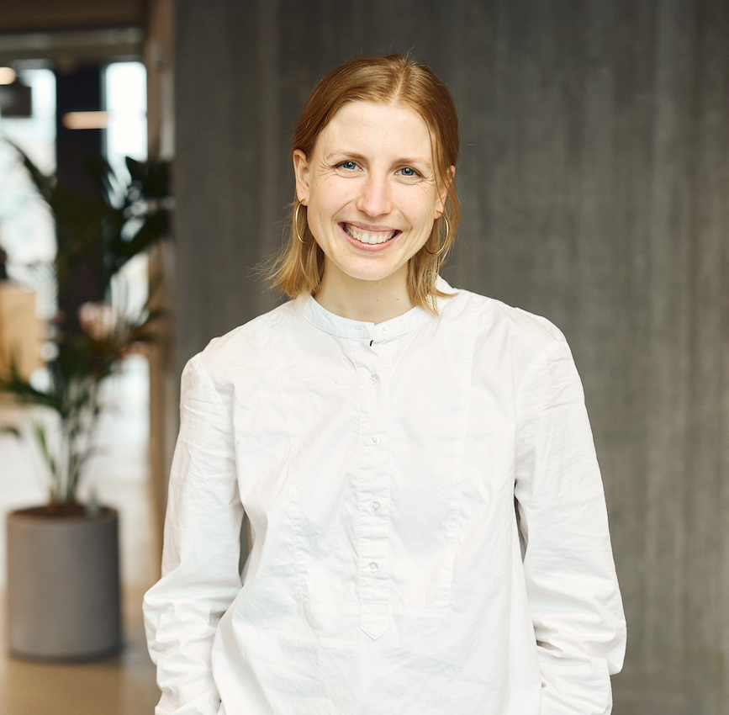
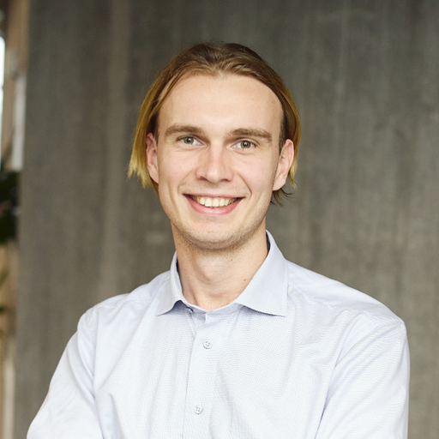
Mathias Hillerup
CCO & Co-founder
Software Engineer by education. Been part of building s360 from the ground up.
Alberte Hannibal
Graduate in sales and expansion at JYSK
Studied Commercial and Retail Management at BSS
Emilie Sunekær
Executive Assistant for Group Management
Studied Ethical Data Science at LSE.
Nicolai Andersen
Sr. Engineer,
Research & Development
Studied Business Intelligence at BSS.

Slide 5








About s360
Who we are
s360 is a leading European digital marketing agency that help brands and retailers grow.
Our team consists of +300 digital specialists working from 10 offices across 7 countries.
In recent years, we has been recognised with numerous national and European awards, making us one of Europe's most award-winning digital marketing agencies.
Founder-led since 2011
+300 digital marketing specialists
10 offices in 7 countries
Specialised in retail and omnichannel
Recognised with +30 marketing awards

Slide 6
Full-service digital marketing agency
Creative Performance
Business strategy
GMP & Partner Technology
Data Intelligence
Measurement
Mrkt. autom.
Digital marketing
UX & CRO
Programmatic
Project Management
Paid Social
Paid Search
SEO
2013
2014
2015
2016
2017
2018
2019
2020
2021
2022
2023
2024

Slide 7
Strong tech foundation
Best-in-class execution
Deep industry expertise
We help our clients build the right data and tech foundation.
We know tech
Bespoke proprietary tech
We offer best-in-class channel understanding and execution.
We are true specialists
One dedicated team
We know what’s next for brands, retailers, and their industry.
It’s not our first time
We know your industry
What we do

Slide 8
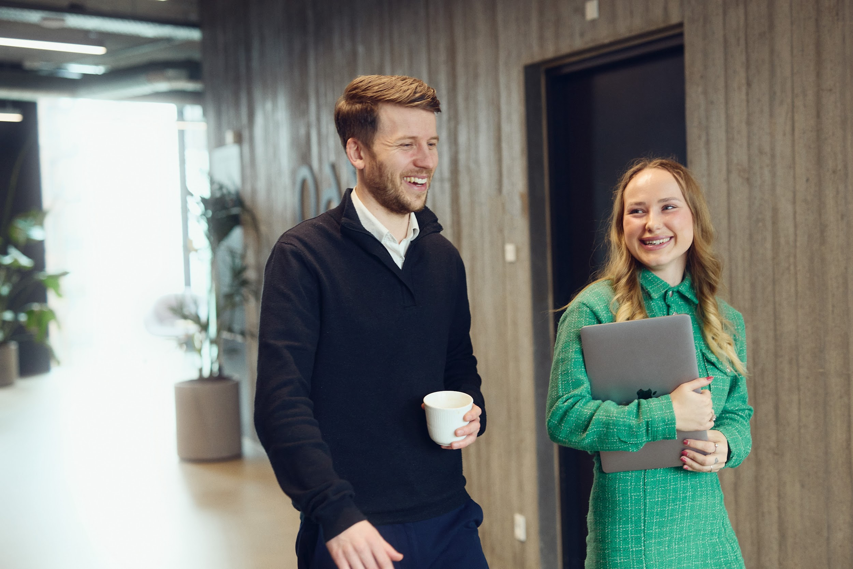



Best-in-class execution
We offer best-in-class channel understanding and execution
True channel specialists
Our +150 marketing specialists are deeply dedicated with one channel each. We are not “jack-of-all-trades” marketing generalists.
A result-driven and proactive team
Our channel experts are driven by results and want our clients to succeed. We don’t just sit and wait, we are proactive at providing advice and taking care of our client’s business - like it was our own.

Slide 9
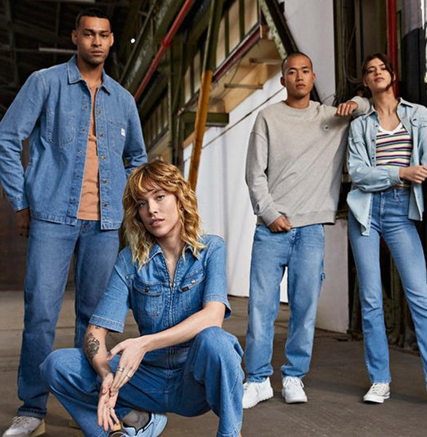
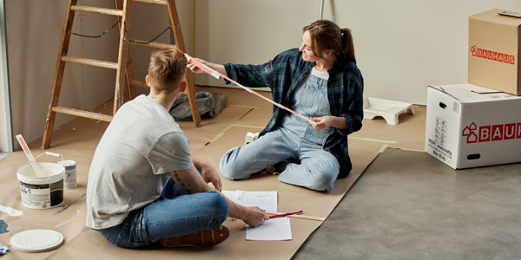
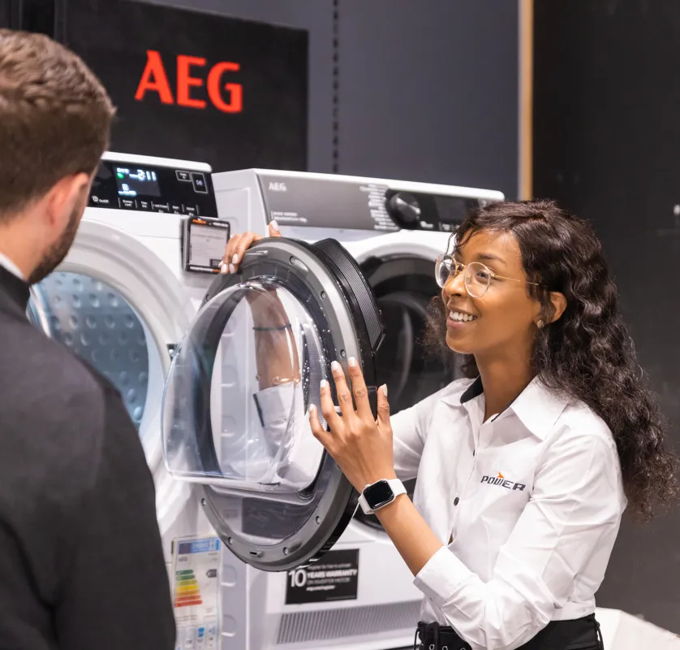

Deep industry expertise
We know what’s next for brands, retailers, and their industry
It’s not our first time
We have +12 years of focused experience working with omnichannel retailers, e-commerce, and international DTC brands. This is our niché.
We know your industry
Our +40 digital growth experts are always on top of the latest news in your category and have access to on-demand market and consumer insights.

Slide 10



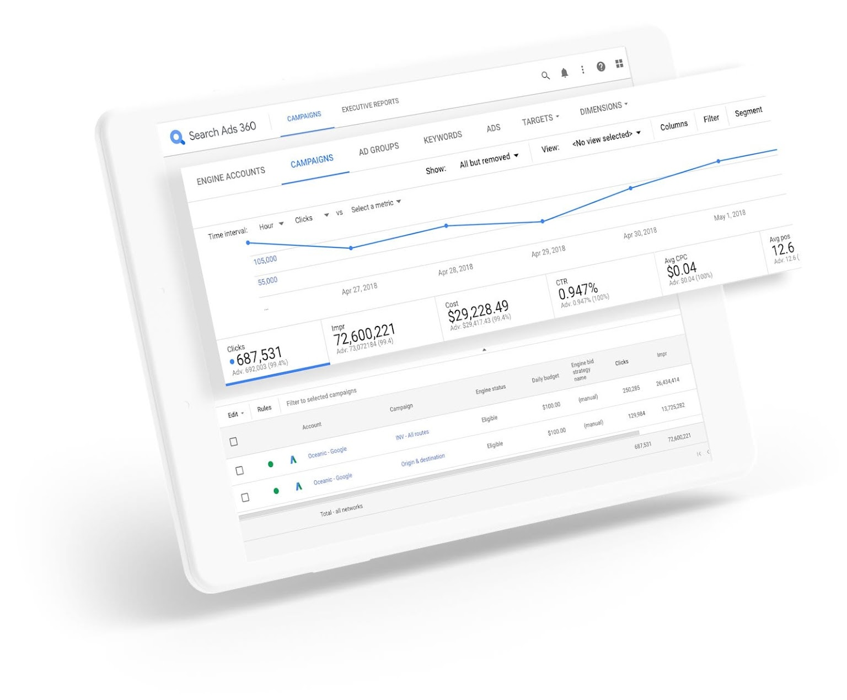










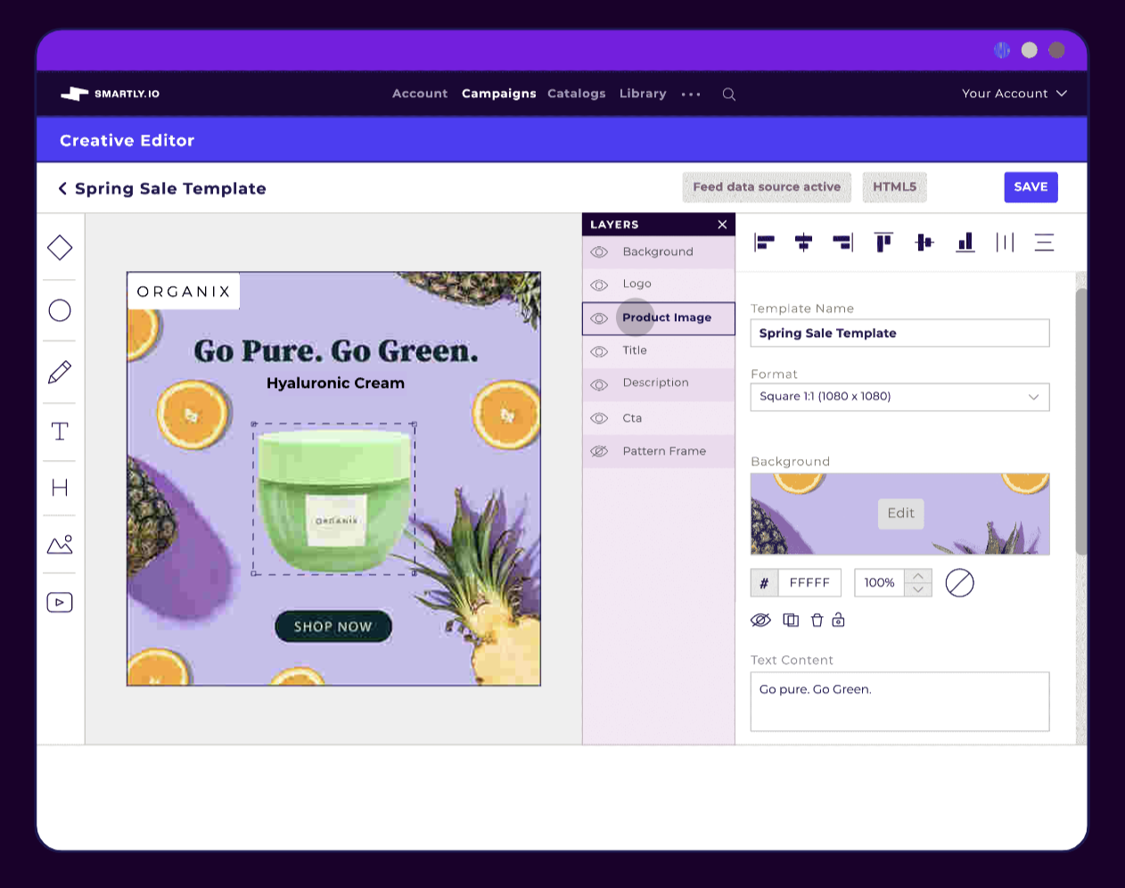
Strong tech foundation
We help our clients build the right data and tech foundation
We know tech
With +30 tech and data experts and +150 active clients using marketing technologies, we know what tech to use and how to use it.
Partner technologies
We are certified partners and resellers of Google Marketing Platform, Google Cloud, and Smartly.
s360 Proprietary tech
We build our own proprietary technology and custom solutions to help our clients succeed with their individual challenges.
Proprietary technologies
s360 Reporting Suite
s360 Quantum Feed Engine
s360 ABBIE
s360 Profit Solution
s360 Core Variant Engine

Slide 11
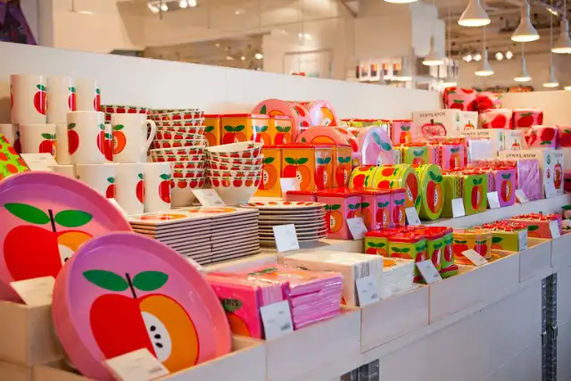
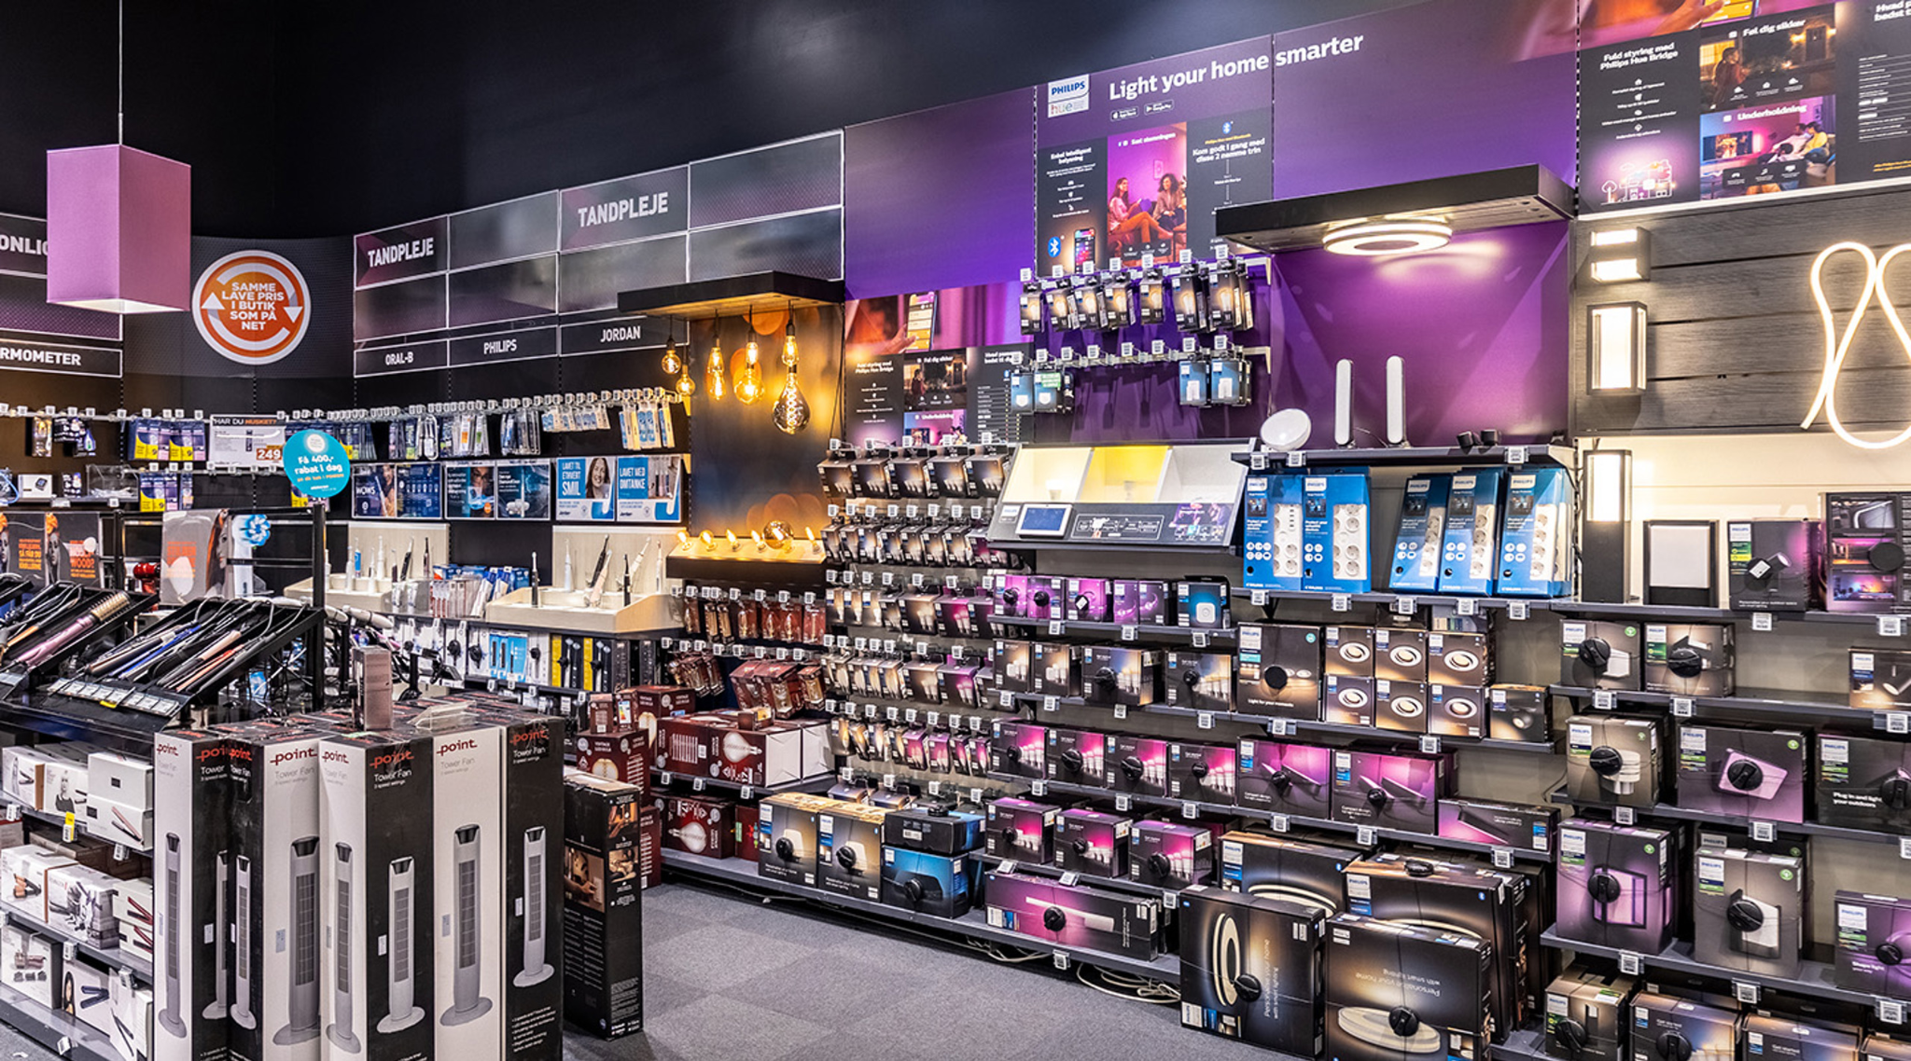


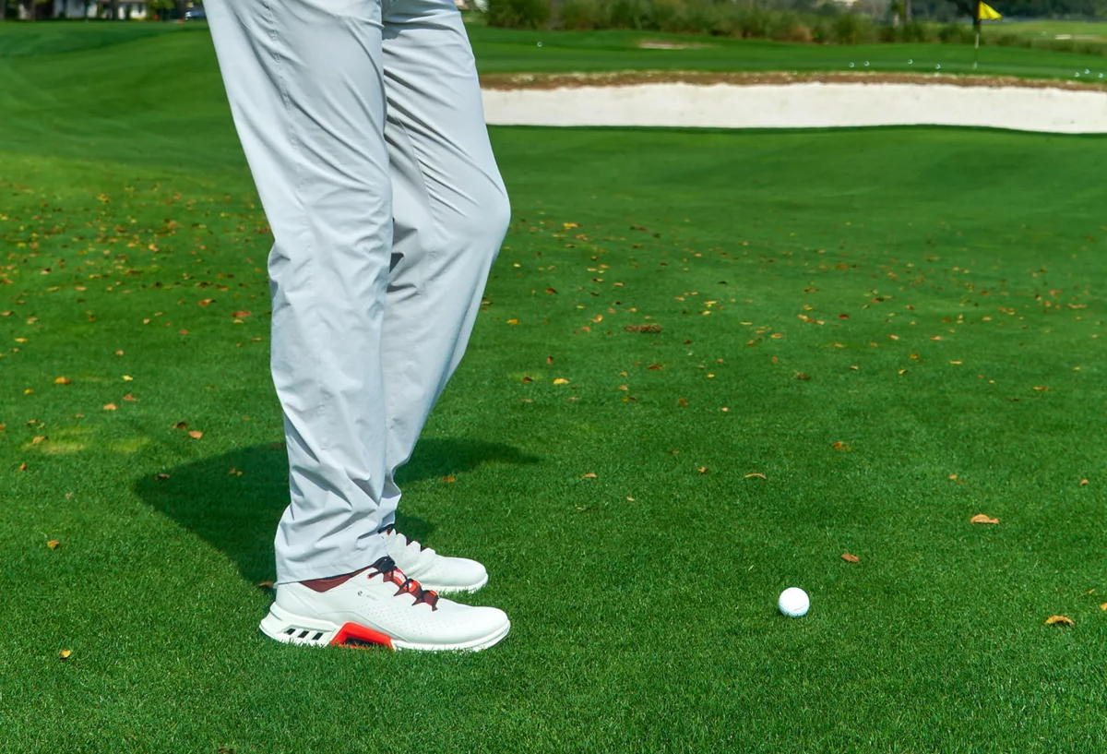





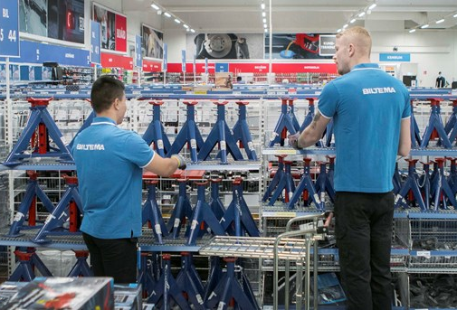

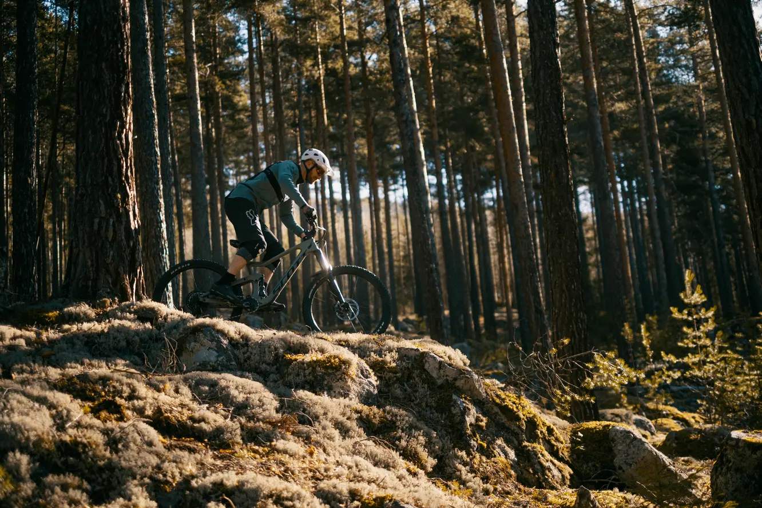
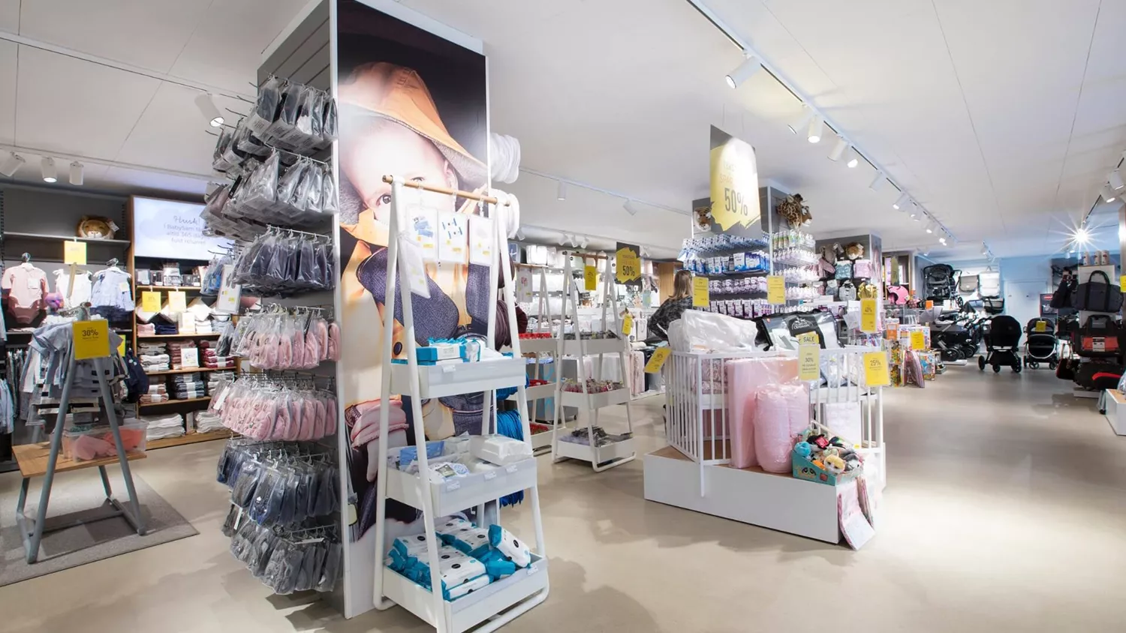






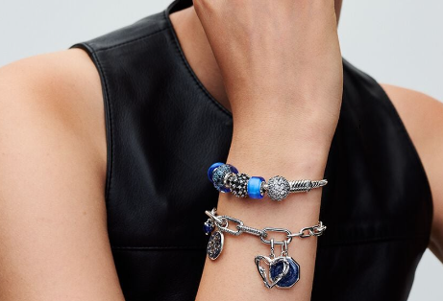
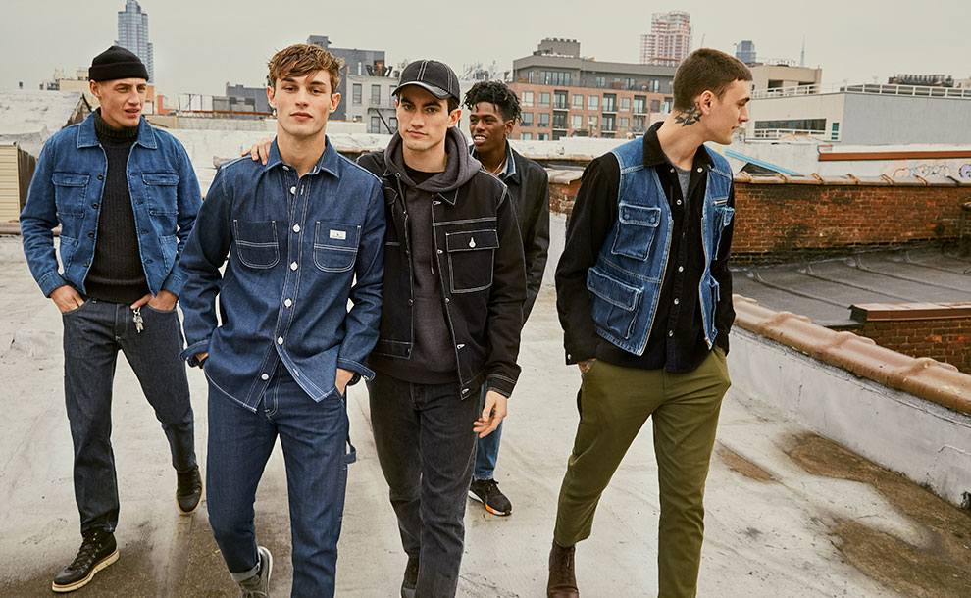
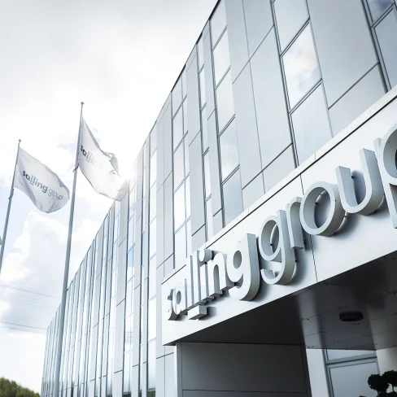
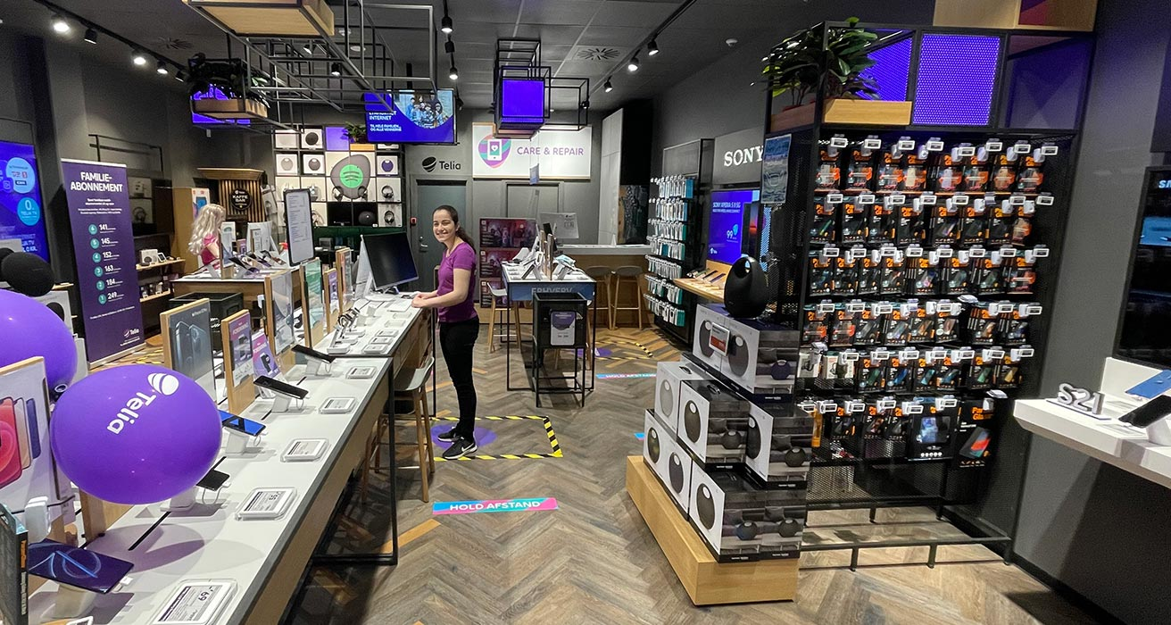





Some of the international Retailers and DTC Brands we help
Extensive multi-market collaborations
20+ markets
4 markets
26 markets
30+ markets
30+ markets
Salling Group
Telia

Slide 12

“So, what kind of
Data do you do”?

Slide 13















s360 Tech Domains
Data engineering and Business Intelligence
Digital commerce
Machine learning and AI
Cloud-native BI
Media-mix modeling (MMM)
Recommendation engine
Predictive modeling with ML
Model fine-tuning
Enterprise Data Warehouse (DWH)
Data marketplaces (3rd party)
Semantic vector search
Custom Agents
Price & Promotion optimization
ETL and Reverse ETL
Data Loss Prevention / Data clean rooms
Product feed optimization
MLops
Anomaly detection
Notes:
Take you through a case competition which we held a couple of weeks ago
nicolai møller asked if it could be interesting : mathias / me
reached out to professors
REached out to nicehair
Soon we had a competition coming up

Slide 14
s360 Tech Domains
Data engineering and Business Intelligence
Digital commerce
Machine learning and AI
Cloud-native BI
Media-mix modeling (MMM)
Recommendation engine
Predictive modeling with ML
Model fine-tuning
Enterprise Data Warehouse (DWH)
Data marketplaces (3rd party)
Semantic vector search
Custom Agents
Price & Promotion optimization
ETL and Reverse ETL
Data Loss Prevention / Data clean rooms
Product feed optimization
MLops
Anomaly detection
Notes:
Take you through a case competition which we held a couple of weeks ago
nicolai møller asked if it could be interesting : mathias / me
reached out to professors
REached out to nicehair
Soon we had a competition coming up

Slide 15
s360 Tech Departments
Data Intelligence
Scalable reporting and intelligence solution.
Purpose:
Ensure correct and easy-to- understand reporting at scale.
Examples:
s360 Marketing Reporting
s360 Share of Search
s360 Shopping Index
Research & Development
New solutions that improve our commercial offerings.
Purpose:
Develop and fine-tune tech solutions to our specialists.
Examples:
s360 Forecasting Platform
s360 Quantum Feed Engine
s360 Core Variant Logic
Cloud
Consultancy and custom client projects.
Purpose:
Help customers with custom data and AI projects.
Examples:
s360 Mixed Marketing Modelling
s360 Looker Enterprise Solution
s360 LookML Data modelling
Notes:
Take you through a case competition which we held a couple of weeks ago
nicolai møller asked if it could be interesting : mathias / me
reached out to professors
REached out to nicehair
Soon we had a competition coming up

Slide 16
➔ Agenda
#1 Introducing s360
#2 JYSK as a Company
#3 Presenting the case
#4 Closing Marks

Slide 17


JYSK company presentation
March 2025

Slide 18


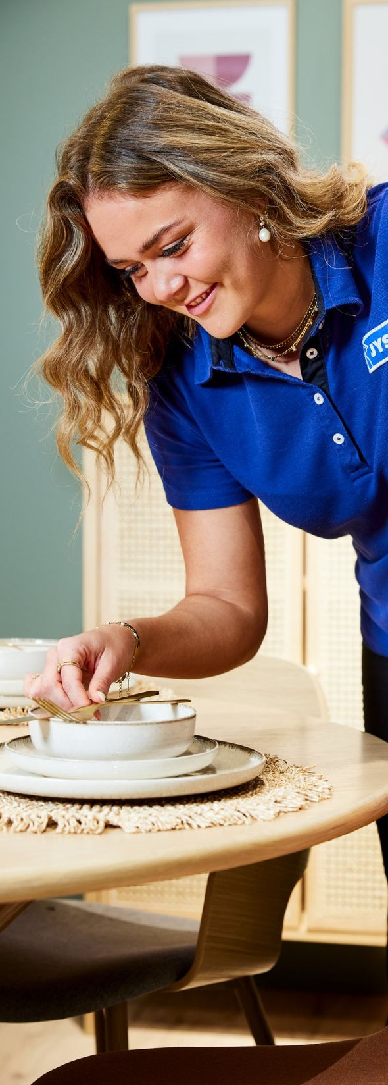





Overview
Mission
Vision
Strategy

Slide 19
Overview
Mission
Vision
Strategy

Slide 20

A family-owned business
JYSK is an international and family-owned home furnishing retailer with Scandinavian roots.
JYSK operates more than 3,500 physical stores and webshops in 48 countries.
JYSK employs 31,000 colleagues.

Slide 21


Our business model
Defining Scandinavian trends
Buying products from suppliers
Transporting products to distribution centres
Checking quality in distribution centres
Distributing products to stores
Marketing of products in relevant channels
Selling products in stores and webshops

Slide 22
Overview
Mission
Vision
Strategy

Slide 23
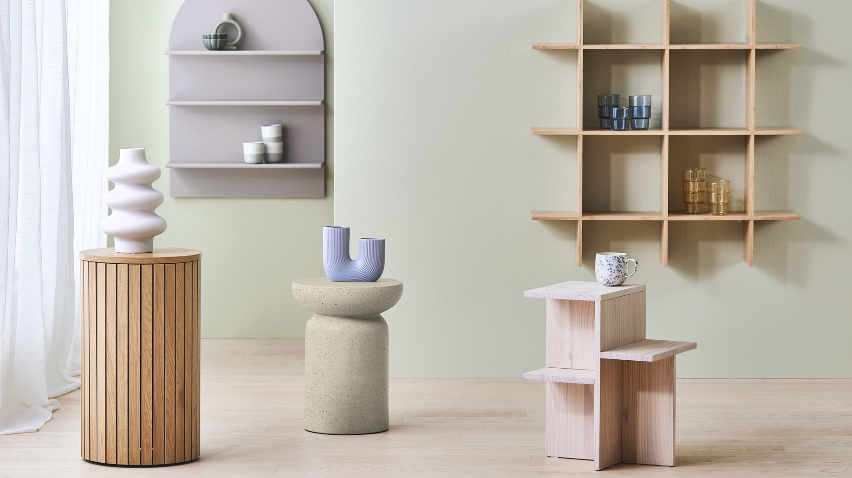

Mission
A great Scandinavian offer for everyone within sleeping and living

Slide 24

Mattresses
Duvets & Pillows
Bed Linen & Sheets
Outdoor Furniture
Scandinavian
product range
Indoor Furniture
Homeware
Home Textiles
Window Dressing
Bathroom

Slide 25
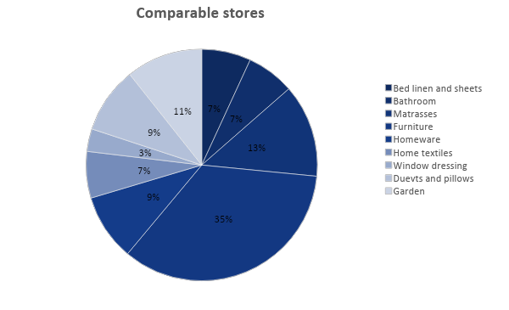
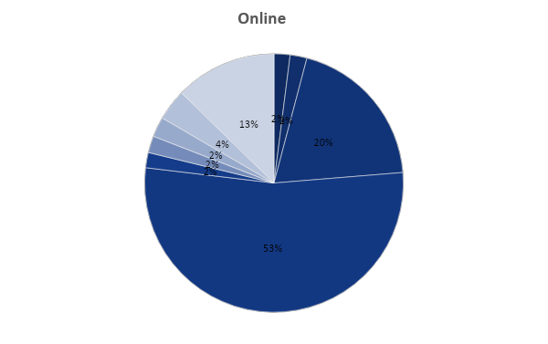
Romania’s current sales share

Slide 26
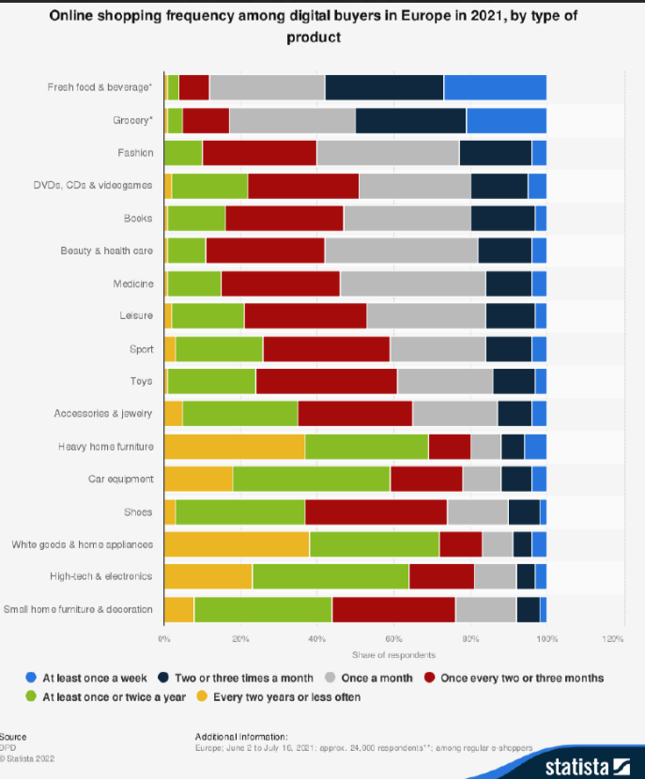


Slide 27


What does
JYSK mean?
The first store was named JYSK SENGETØJSLAGER, which means ”bed linen warehouse”.
Since 2021, all stores have been named simply JYSK.
The Danish word ‘jysk’ means someone or something originating from the peninsula of Jutland in Denmark.
It also refers to a certain culture and way of life. People from Jutland are generally considered to be hard-working, reliable and down-to-earth.
JUTLAND

Slide 28
Overview
Mission
Vision
Strategy

Slide 29
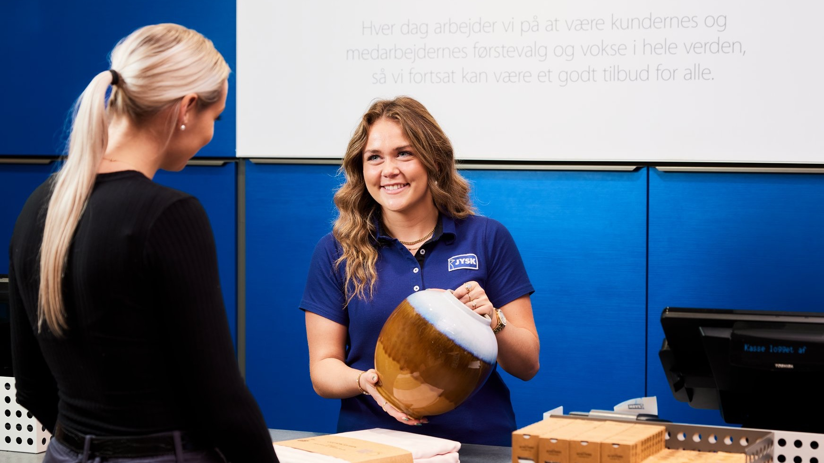

Vision
To be customers’ first choice
To be employees’ first choice within retail
To be the world’s most widespread and profitable chain of stores

Slide 30
Vision
To be customers’ first choice
To be employees’ first choice within retail
To be the world’s most widespread and profitable chain of stores

Slide 31


Customer promises
You get great offers
You get reliable quality
You get easy shopping
You get competent service

Slide 32


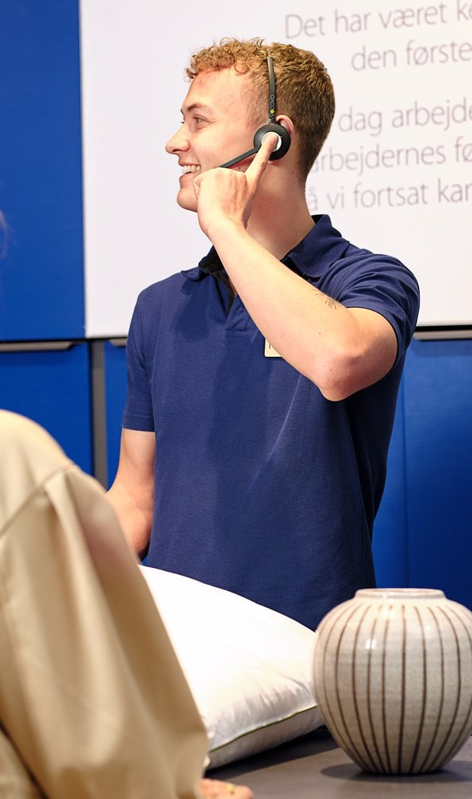
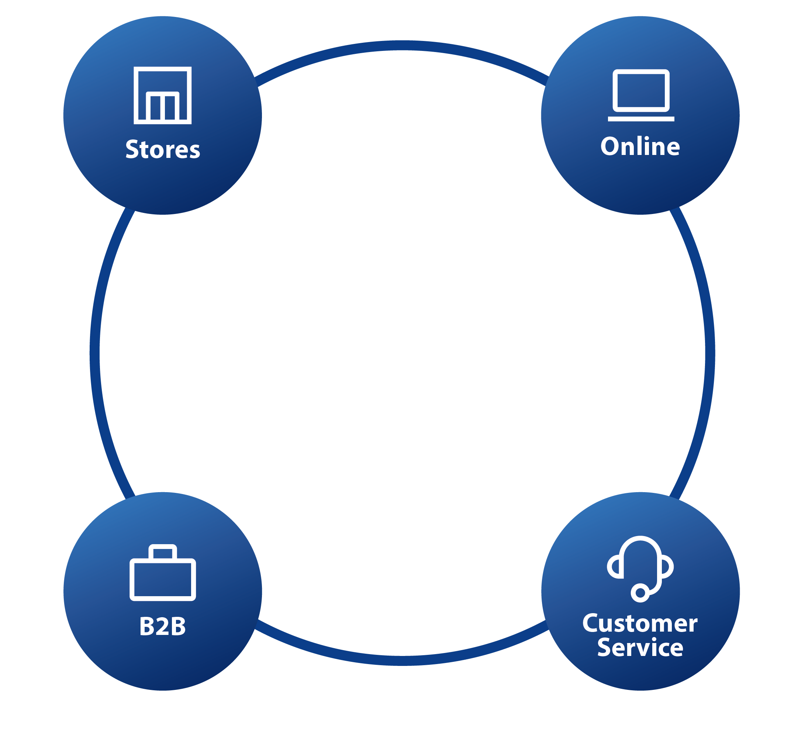
The integrated buying experience
Buy in store or online
Click & Collect or direct delivery
Shared customer service
Return anywhere

Slide 33
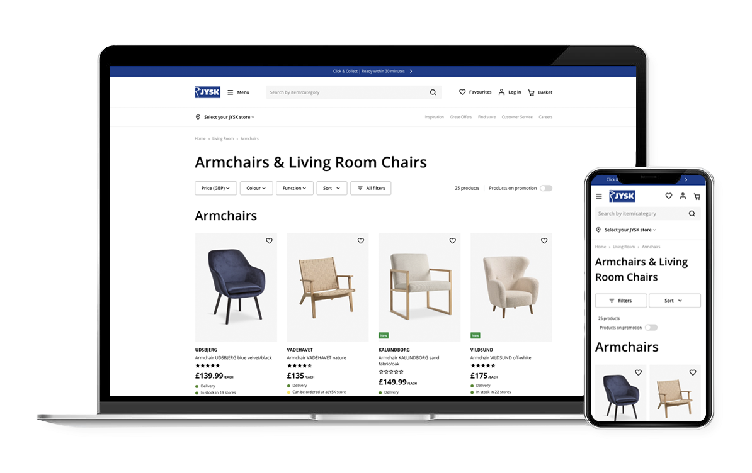
JYSK
Webshops
We have webshops in all JYSK countries and want to offer customers a seamless shopping experience.
We have three different types of delivery for customers
CLICK & COLLECT Online reservation of a product already in a store, which is put aside by a store employee and paid for in the store
OOPUS (Order Online – Pick Up in Store) Free delivery option of a product currently not in a store, but delivered for pick up in a store
HOME DELIVERY with a freight company

Slide 34
Jysk’s Online Sales Share vs. Romania
Jysk
10,1%
Romania
8,2%
Notes:
How to Increase Romania's Share?

Slide 35
Vision
To be customers’ first choice
To be employees’ first choice within retail
To be the world’s most widespread and profitable chain of stores

Slide 36
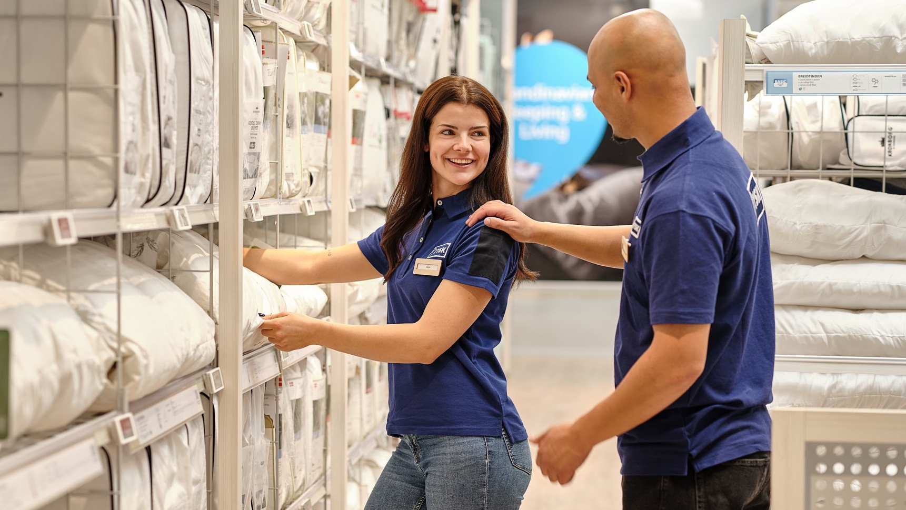
JYSK
Employee Promises
Strong
teams.
Great
engagement.
Bring
dedication.
Meet
possibilities.

Slide 37
Vision
To be customers’ first choice
To be employees’ first choice within retail
To be the world’s most widespread and profitable chain of stores

Slide 38
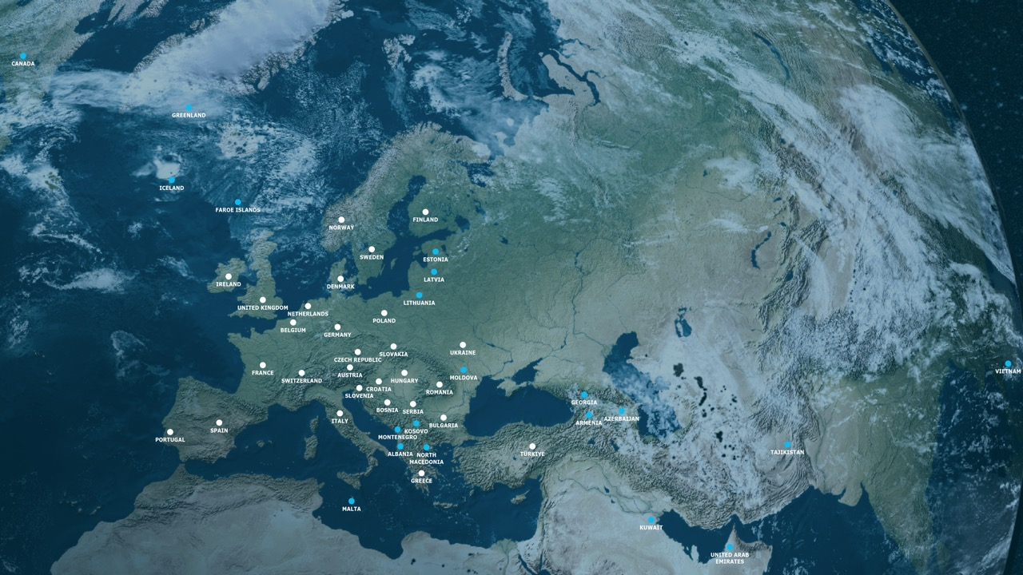

3,505 JYSK stores
As of 28 February 2025 (incl. webshops)
JYSK 28 countries 3,288 stores
JYSK FRANCHISE 20 countries 217 stores

Slide 39
v
3,288 JYSK stores
Germany | 939
Poland | 314
Sweden | 159
Spain | 157
Romania | 149
Denmark | 116
Czech Republic | 108
Norway | 108
Netherlands | 105
Ukraine | 105
Hungary | 101
Italy | 99
Finland | 93
Austria | 92
France | 73
Switzerland | 72
Croatia | 67
Belgium | 66
Greece | 65
Bulgaria | 57
Slovakia | 51
Serbia | 48
Bosnia-Herz. | 31
Portugal | 30
Slovenia | 27
United Kingdom | 26
Ireland | 25
Türkiye | 5
As of 28 February 2025 (incl. webshops)

Slide 40


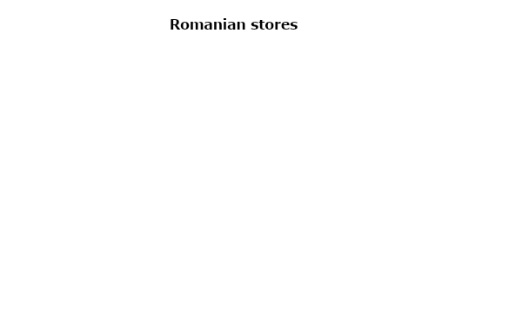
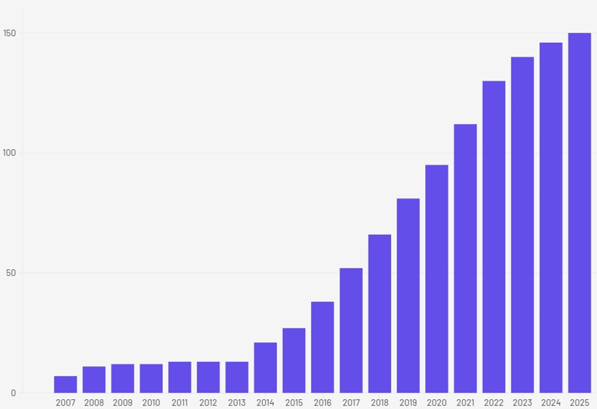
EVOLUTION OF ROMANIAN STORES
No of stores

Slide 41
Overview
Mission
Vision
Strategy

Slide 42

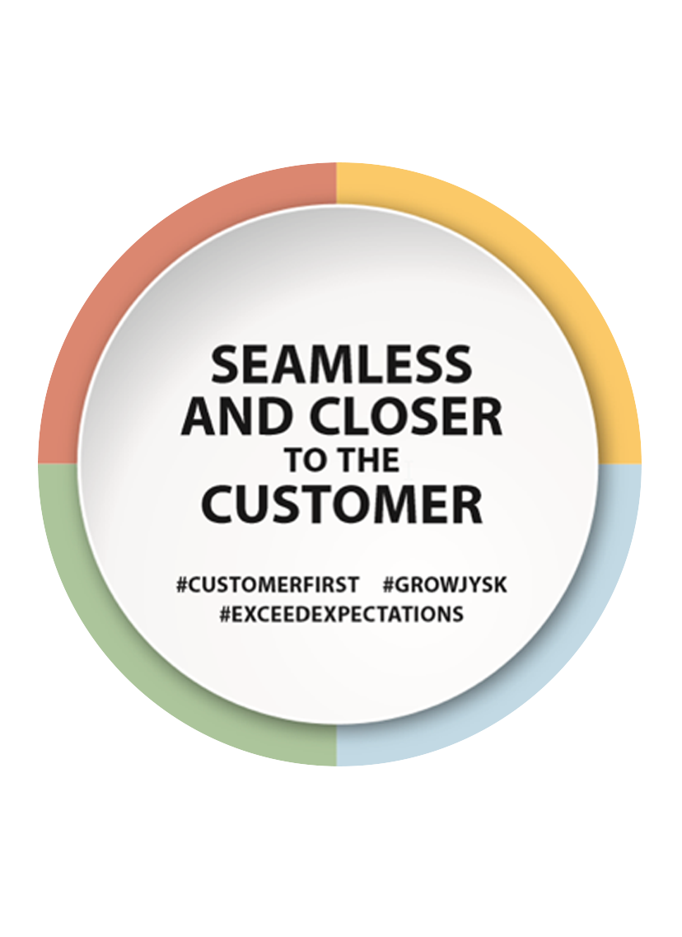
JYSK Strategy 2020-2025
To win we need to make it easy and convenient for our customers to choose JYSK, no matter where or how they want to shop.
We need to be closer to our customers, both by opening stores close to them and by understanding them and their needs even better.
That is why our strategy is called: Seamless and Closer to the Customer.

Slide 43
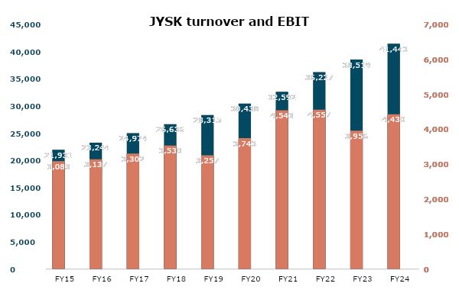
Results
2023/24
Our financial year runs from 1 September to 31 August. The figures cover only JYSK and not JYSK Franchise.
TURNOVER
(billion DKK)
EBIT
(billion DKK)

Slide 44
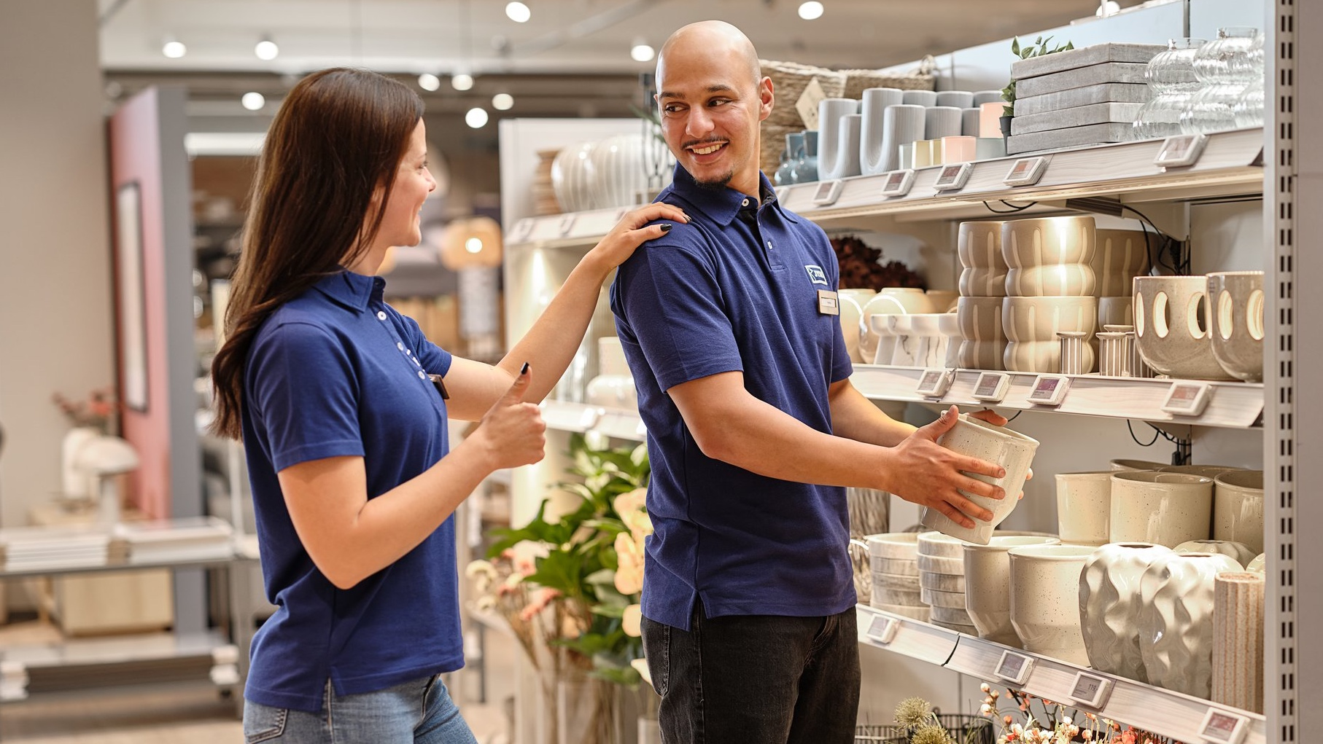
Thank you!

Slide 45
➔ Agenda
#1 Introducing s360
#2 JYSK as a Company
#3 Presenting the case
#4 Closing Marks

Slide 46
So why is CA so important : The current trend in marketing
One size fits all
91%
1:1 communication
Integrated
Return on investment
Trigger based
of shoppers are more likely to buy from a company that offers personalized experiences
Targeted
One size, fits all
One size fits all
Data-driven

Slide 47
Today Case : Enhance JYSK’s Customer Experience with Data-Driven Insights
Your mission is to develop a data-driven solution that increases profitability, enhances product recommendations and identifies purchase patterns.
The problem statement:
“How can JYSK use customer analytics to become more effective in identifying product relationships and cross-selling opportunities?”

Slide 48

Today Case : The Requirements
We will upload the data and case registration paper after today's lecture
Work in groups:
2-4 people
Work in the areas:
Customer life time prediction & segmentation
Product Recommendations
Association rule mining
Segmentation based on products
Hand in:
Technical report
Slides (max 6)

Slide 49
Todays case: The data available
You will be provided all Romanian online orders from 2024. The dataset will contain:
Transaction & Customer Data
Product Data
Order_id | Customer_id | Order_value | Customer_zip_code
…. | …. | ….
Product_id | Product_title | Product_group_level_1 | Product_category_level_2
 |  | …. | ….
We will upload the data and case registration paper after today's lecture

Slide 50
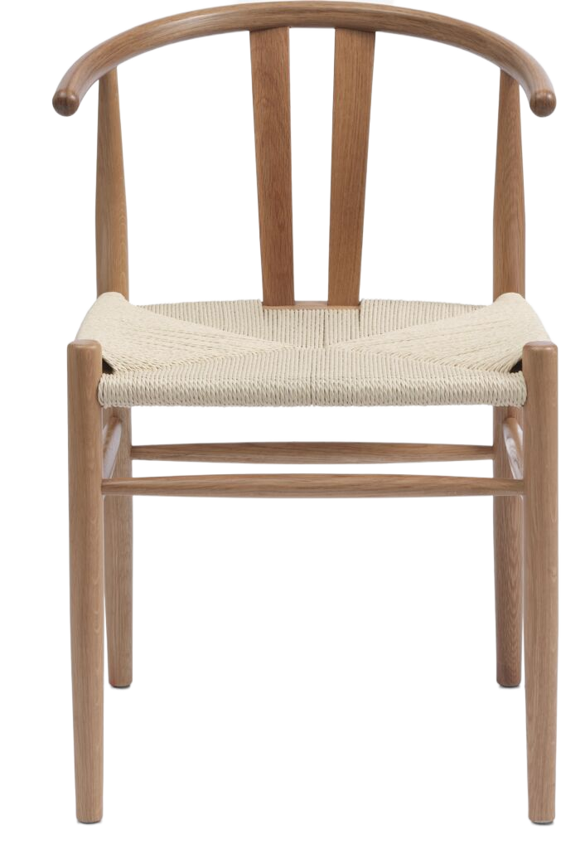


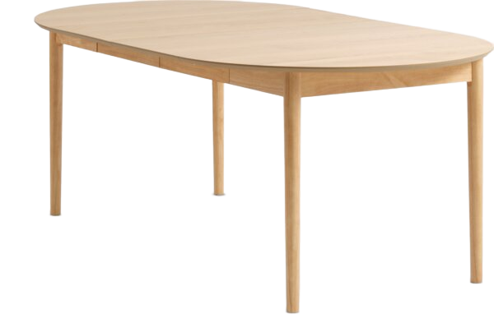

Todays case: Examples of potential use cases for new segments or product recommendations
New onsite Recommendations
Personalized Recommendations
Segments & Personalized ads
Your
ideas

Slide 51
➔ Agenda
#1 Introducing s360
#2 JYSK as a Company
#3 Presenting the case
#4 Closing Marks

Slide 52
Todays Case: Enhance Jysk’s Customer Experience with Data-Driven Insights
Deliveries
Evaluation Criteria
Method and Data
Technical Report:
Outlining your analysis process, algorithms used, and findings (1 markdown file)
Slides:
Highlighting key insights and proposed recommendations
(Max. 6 reading slides)
Technical skills: Methodologies and data analysis
(Ana Tudoran & Morten Berg, Professor, Aarhus University, 33,3%).
Business impact:
Potential uplift in average basket size and repurchase rate
(Ruxandra Radu, Regional Sales Manager Romania & Bulgaria, Jysk, 33,33%).
Innovation:
Creative approaches and potential for insights
(Mathias Hillerup, CCO and Co-founder, s360, 33,33%).
Methodologies
The methods and theories for solving this case are located under the methodology: Segmentation, Predictions, Product Recommendation (incl. Collaborative filtering) and Association rules mining.
Data
You will be provided with a dataset containing: 424.965 rows split into 173.275 orders. All Romanian Online Orders in 2024 from Jysk

Slide 53


Todays Case: Enhance Jysk’s Customer Experience with Data-Driven Insights
Time Schedule
Registration Deadline:
24th of March in the sheet shared after today.
Submission Deadline:
31th of March at 12 pm. Submitted to the shared email-address.
Final Presentations:
4th of April - The three best cases will present (Informed beforehand).
1, 2 and 3rd places will be granted a present from JYSK. Moreover, all finalists will have the opportunity for a career consultation session with, s360's CCO, Mathias Hillerup.

Slide 54
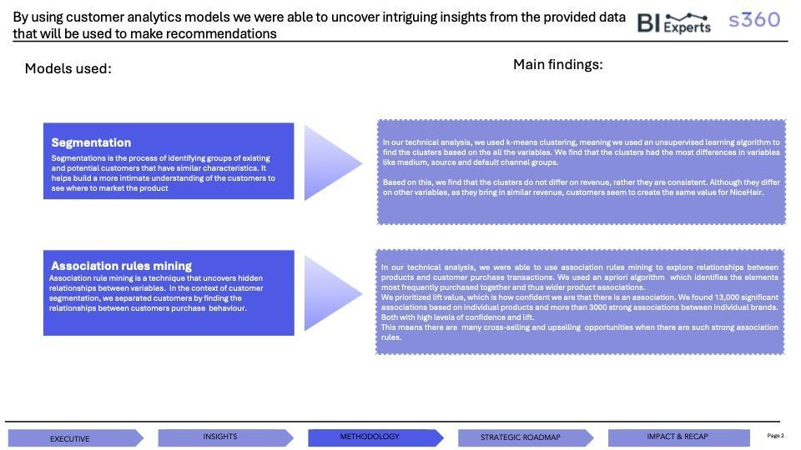
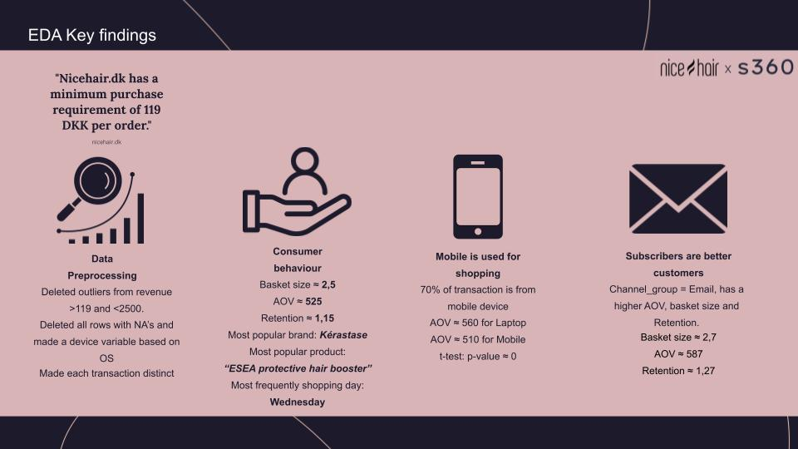
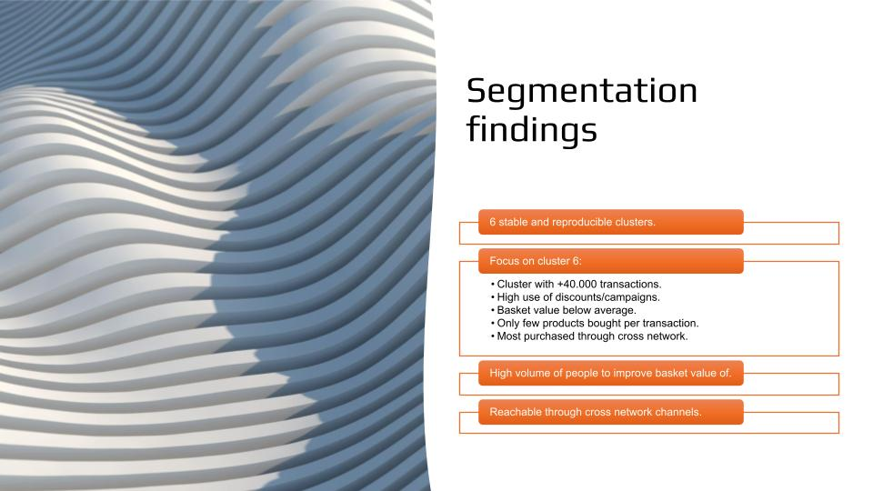
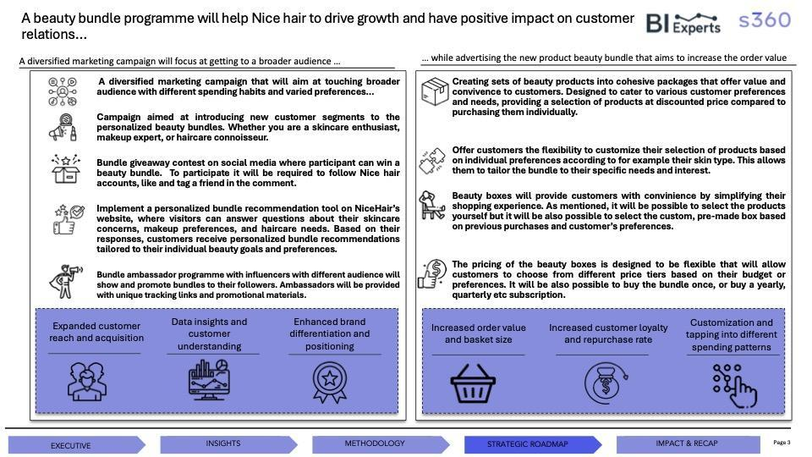
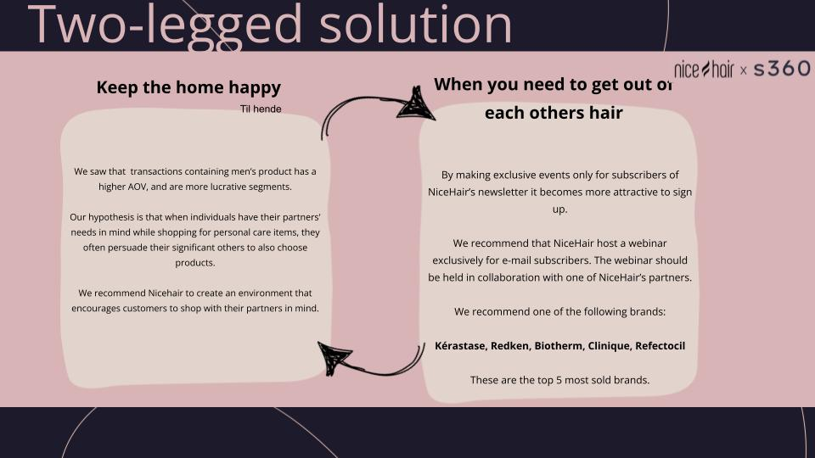
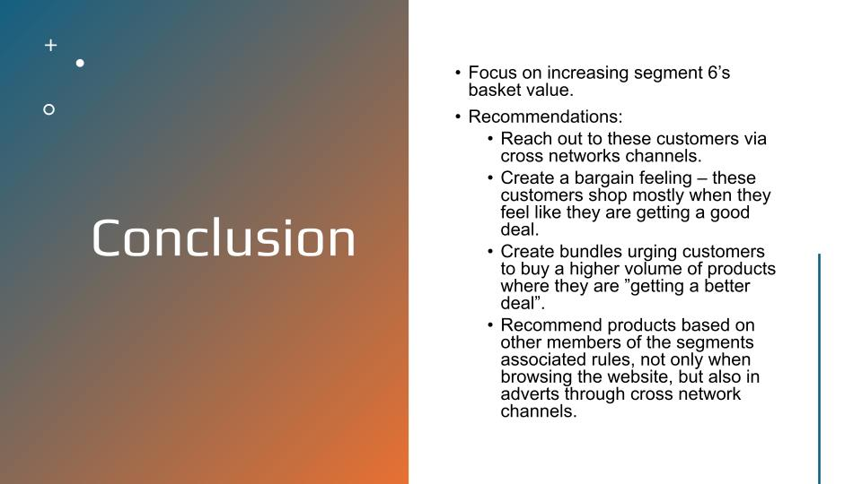
Last year we ended up with three very well presented and value giving solutions for Nicehair
1
2
3
Notes:
we ended up by deciding which 3 really relevant and applicable cases which should be presented
all delved into either
bundles : personal bundles or bundles as in shampoo goes withcondition
New shopping incitements : in terms of getting women to buy stuff for their better half
from those, together with susanne and the professors, mathias decided on the first case BI expert would be the winner
as they provided a extensive data set and delved into the business value

Slide 55
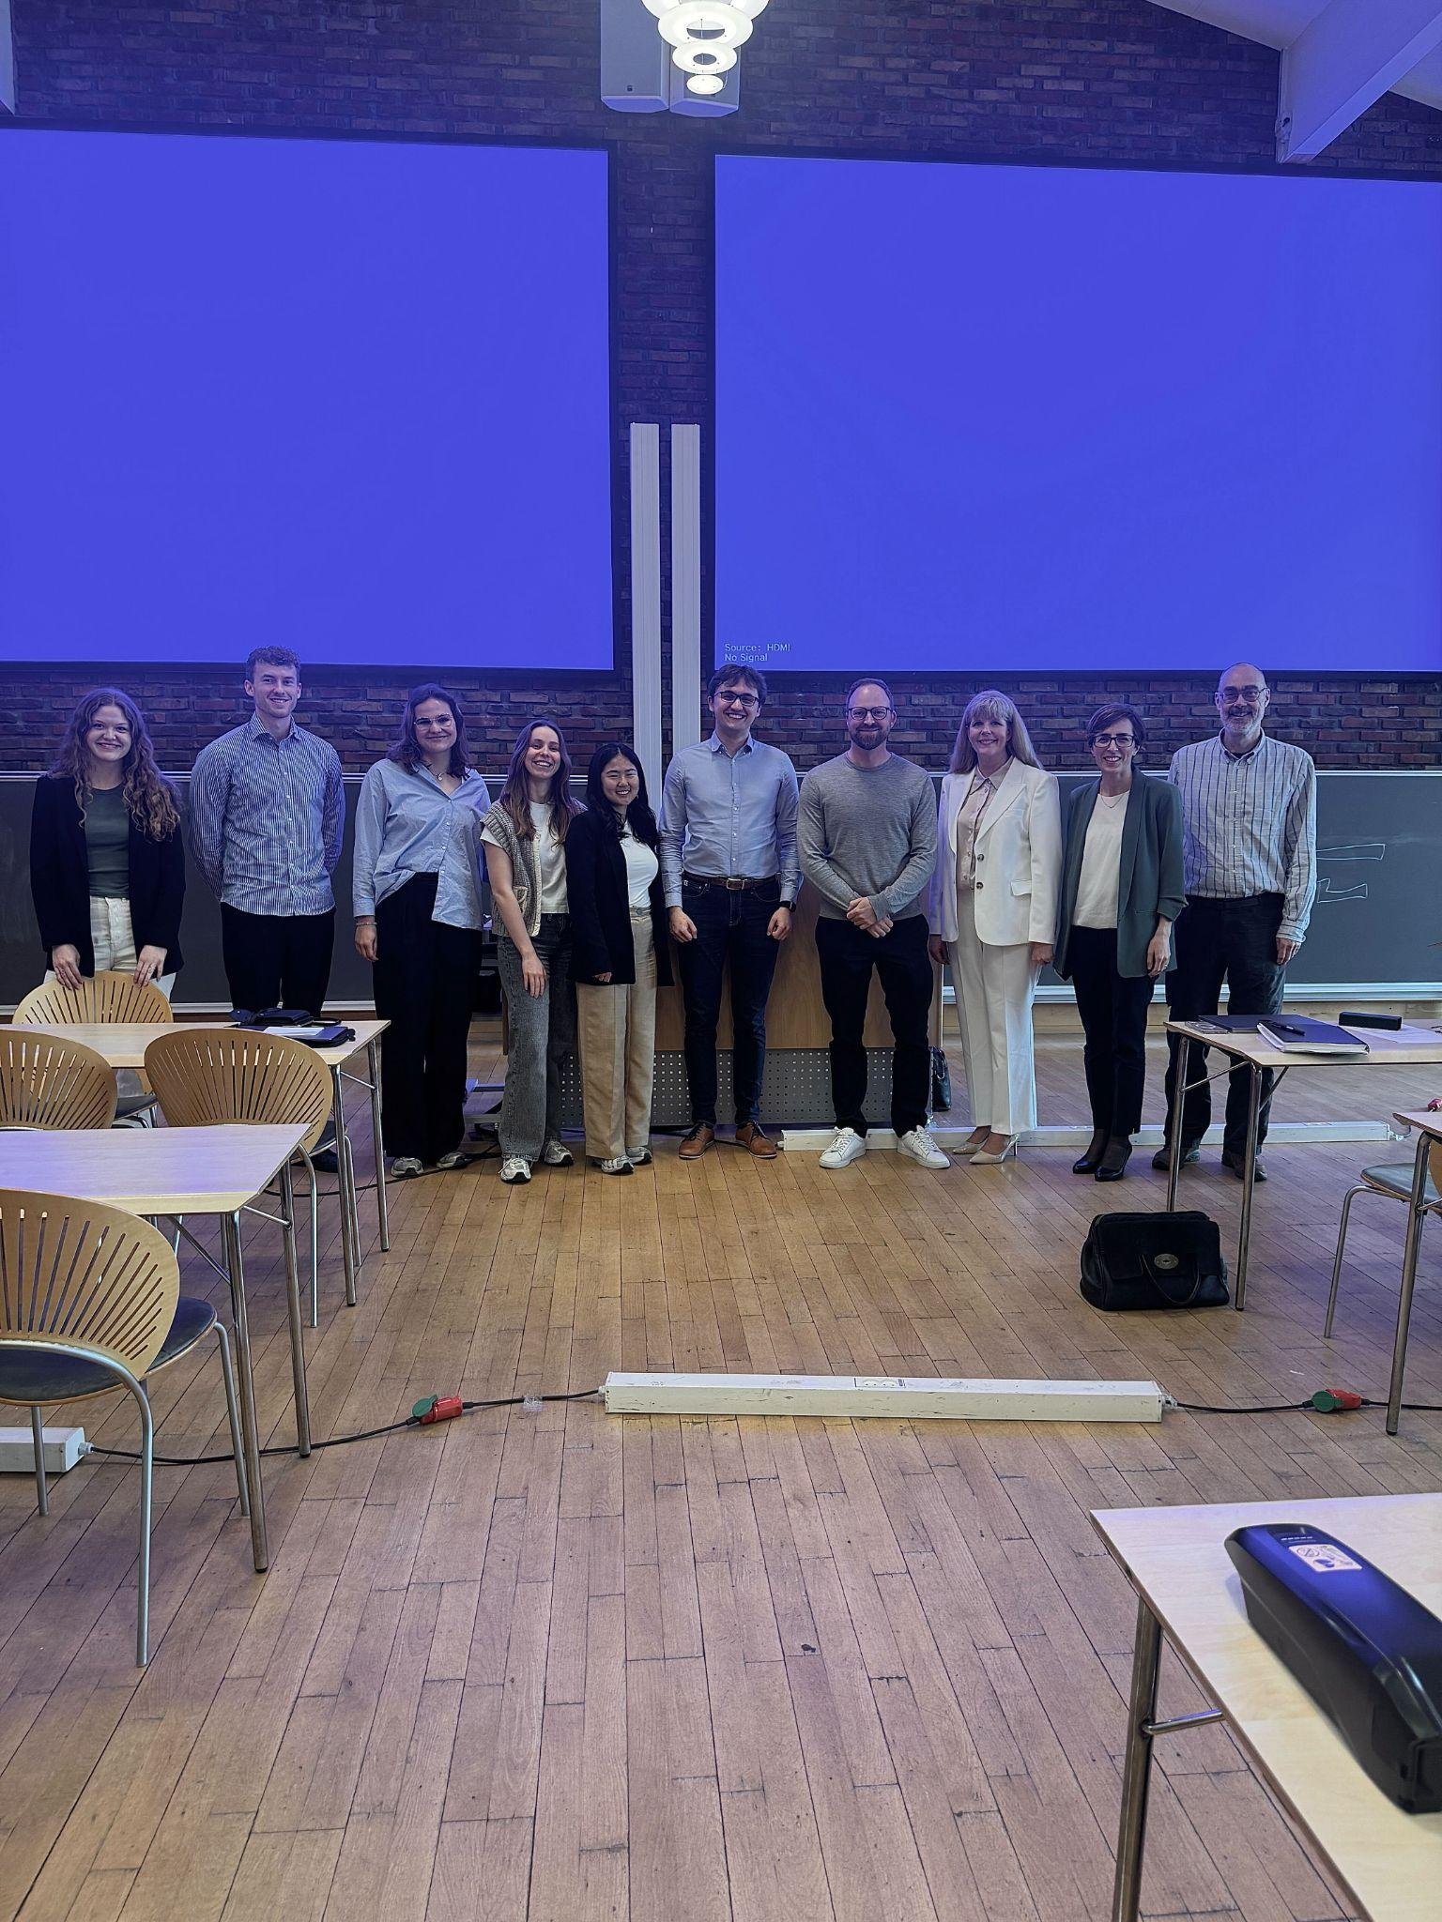
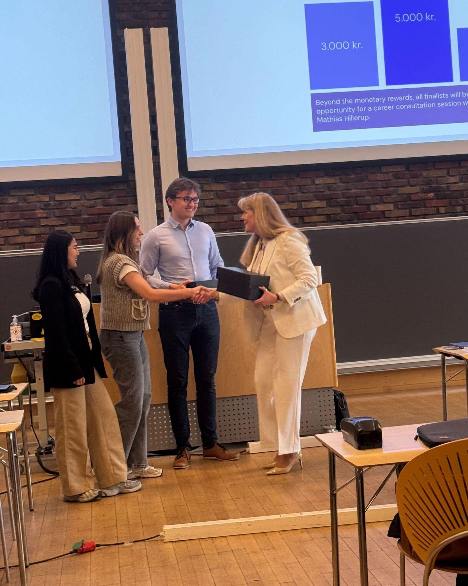
Last year we ended up with three very well presented and value giving solutions for Nicehair
Notes:
ended up by giving handing over the prizes
5000 to 2000

Slide 56
Contact: Emilie Sunekær – ech@s360digital.com Nicolai Møller Andersen – nma@s360digital.com

